Slide 1
INTRODUCTION TO HIVE
Hive is a Data Warehousing tool.
Hive is used to query structured data built on top of Hadoop.
Facebook created Hive component to manage their ever-growing volumes of log data.
Hive makes use of the following:
1. HDFS for Storage.
2. MapReduce for execution.
3. Stores metadata in an RDBMS.

Slide 2
Hive features
It is similar to SQL.
HQL is easy to code.
Hive supports rich data types such as structs, lists, and maps.
Hive supports SQL filters, group-by and order-by clauses.
CustomTypes, Custom Functions can be defined.

Slide 3
Hive Data Units
Databases: The namespace for tables.
Tables: Set of records that have similar schema.
Partitions: Logical separations of data based on classification of given information as per specific attributes. Once hive has partitioned the data based on a specified key, it starts to assemble the records into specific folders as and when the records are inserted.

Slide 4
Buckets (or Clusters): Similar to partitions but uses hash function to segregate data and determines the cluster or bucket into which the record should be placed.

Slide 5
Hive Architecture
Hive Command-Line Interface (Hive CLI): The most commonly used interface to interact with Hive.
Hive Web Interface: It is a simple Graphic User Interface to interact with Hive and to execute query.
Hive Server: This is an optional server. This can be used to submit Hive Jobs from a remote client.

Slide 6
]DBC I ODBC: Jobs can be submitted from a JDBC Client. One can write a Java code to connect to Hive and submit jobs on it.
Driver: Hive queries are sent to the driver for compilation, optimization and execution.
Metastore: Hive table definitions and mappings to the data are stored in a Metastore.

Slide 7
A Metastore consists of the following:
• Metastore service: Offers interface to the Hive.
• Database: Stores data definitions, mappings to the data and others.
The metadata which is stored in the metastore includes IDs of Database, IDs of Tables, IDs of Indexes.

Slide 8
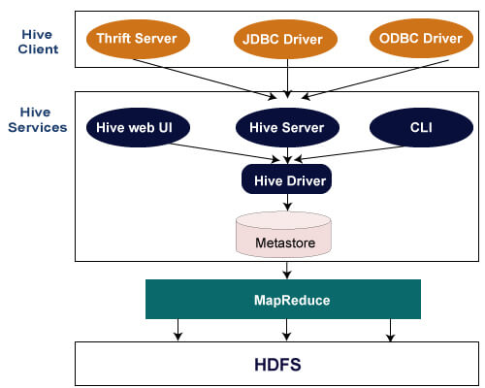

Slide 9
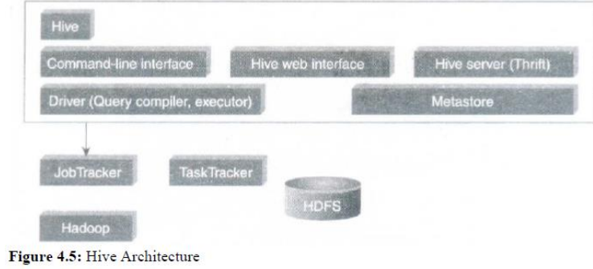

Slide 10
There are three kind of metastore.
Embedded Metastore:
This metastore is mainly used for unit tests.
Here, only one process is allowed to connect to the metastore at a time.
This is the default metastore for Hive.
It is Apache Derby Database.
In this metastore, both the database and the metastore service runs, embedded in the main Hive Server process.

Slide 11


Slide 12
2. Local Metastore:
Metadata can be stored in any RDBMS component like MySQL.
Local metastore allows multiple connections at a time.
In this mode, the Hive metastore service runs in the main Hive Server process, but the metastore database runs in a separate process, and can be on a separate host.

Slide 13
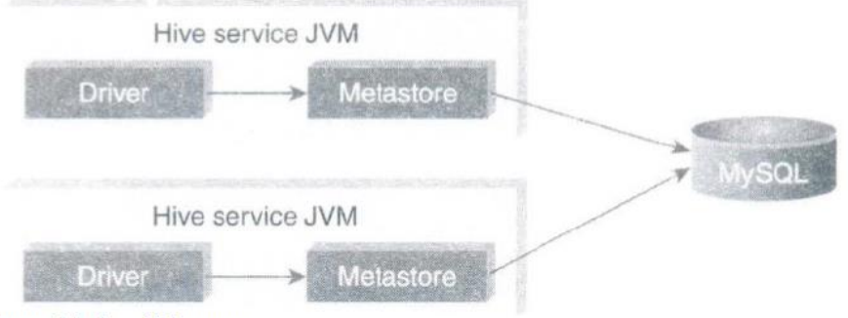

Slide 14
3. Remote Metastore:
In this, the Hive driver and the metastore interface run on different JVMs (which can run on different machines as well) a

Slide 15
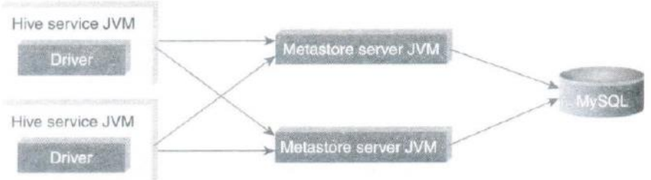

Slide 16
Hive Data Types
Primitive data types and Collection data types.
Primitive Data Types-Can be classified as Numeric, String, and Miscellaneous types(boolean)

Slide 17
Collection Data Types:-
STRUCT
MAP
ARRAY

Slide 18
Hive File Format
The file formats in Hive specify how records are encoded in a file.
The default file format is text file.

Slide 19
CREATE TABLE my_text_table (
column1 INT,
column2 STRING,
column3 DOUBLE
)
ROW FORMAT DELIMITED
FIELDS TERMINATED BY '\t' -- Specify the field delimiter (e.g., tab)
LINES TERMINATED BY '\n' -- Specify the line delimiter (newline)
STORED AS TEXTFILE;

Slide 20
Sequential File: Sequential files are Bat files that store binary key-value pairs.
It includes compression support which reduces the CPU, I/O requirement.
In Hive, a sequential file format refers to a type of file format that is used for storing data in a serialized, compact, and efficient manner.
These formats are optimized for sequential access, making them suitable for use cases where data is read or written sequentially rather than randomly.

Slide 21
RCFile (Record Columnar File):
RCFile is a columnar file format that stores data column-wise rather than row-wise, which can lead to better compression and query performance for certain workloads.
It is efficient for read-heavy workloads where you only need specific columns from a table, as it allows for column pruning.
RCFile is especially suitable for data warehousing and analytics use cases.

Slide 22
RCFILE IMPLEMENTATION
RCFile (Record Columnar File) is a data placement structure that determines how to store relational tables on computer clusters.

Slide 23
SERDE
In Hive, a SERDE(Serializer/Deserializer) is a fundamental component that enables you to define how data is serialized (converted to a binary format) for storage and how it is deserialized (converted back to its original format) when retrieved from storage.
SERDEs are used for data serialization and deserialization within Hive tables, making it possible to work with different data formats and structures

Slide 24
User Defined Functions (UDFs)
User Defined Functions (UDFs) in Hive allow you to extend the functionality of Hive by defining your own custom functions.
These functions can be written in various programming languages, such as Java, Python, and others, and can be used to perform custom operations on the data within Hive queries.
UDFs are particularly useful when you need to apply complex or specialized logic to your data that is not achievable with Hive's built-in functions.

Slide 25
To create a UDF that calculates the square of a number.
Do this using Java, as Hive supports UDFs written in Java.
Create a simple Java-based UDF for squaring a number:

Slide 26
import org.apache.hadoop.hive.ql.exec.UDF;
import org.apache.hadoop.io.IntWritable;
public class SquareUDF extends UDF {
public IntWritable evaluate(IntWritable num) {
if (num == null) return null;
return new IntWritable(num.get() * num.get());
}
}

Slide 27
Compile the Java code into a JAR file and make it available to Hive.
Register the UDF in Hive:
Add the JAR file to the Hive classpath and register the UDF before you can use it in your Hive queries.
ADD JAR /path/to/SquareUDF.jar;

Slide 28
Use the UDF in a Hive query:
SELECT num, SquareUDF(num) AS squared_num FROM input_table;

Slide 29
Hive Query Language
Create and manage tables and partitions.
Supports various Relational, Arithmetic, and Logical Operators.
Evaluate functions.
Download the contents of a table to a local directory or result of queries to HDFS directory.

Slide 30
DDL (Data Definition Language) Statements
These statements are used to build and modify the tables and other objects in the database.
The DDL commands are as follows:
Create/Drop/Alter Database
Create/Drop/Truncate Table
Alter Table/Partition/Column

Slide 31
Create/Drop/Alter View
Create/Drop/Alter Index
Show
Describe

Slide 32
DML (Data Manipulation Language) Statements
These statements are used to retrieve, store, modify, delete, and update data In database.
Database: A database is like a container for data.
It has collection of tables which houses data.

Slide 33
Open a terminal and start the Hive shell by typing:
Hive
Create a database using the CREATE DATABASE command.
CREATE DATABASE mydb;
To switch to the newly created database, use the USE command
USE mydb;

Slide 34
To create tables within your database, you can use the CREATE TABLE command.
CREATE TABLE employees (
employee_id INT,
first_name STRING,
last_name STRING,
salary FLOAT
);

Slide 35
You can insert data into your table using the INSERT INTO command or by loading data from external sources.
INSERT INTO employees VALUES
(1, 'John', 'Doe', 50000.0),
(2, 'Jane', 'Smith', 60000.0),
(3, 'Bob', 'Johnson', 55000.0);

Slide 36
You can run SQL queries on your data, such as SELECT, INSERT, UPDATE, and DELETE using the HiveQL language.
SELECT * FROM employees;

Slide 37
Create a Hive table:
To create a table in Hive where you want to load the data.
Use the CREATE TABLE statement
CREATE TABLE employees ( employee_id INT, first_name STRING, last_name STRING, salary FLOAT );

Slide 38
Prepare your data file:
Make sure you have a data file in a supported format (e.g., CSV, TSV, or any other delimited format) with the data you want to load into the table.
For this example, let's assume you have a CSV file named employee_data.csv with the following content:
4,Michael,Johnson,65000.0 5,Emily,Smith,58000.0

Slide 39
Upload the data file to Hadoop HDFS:
Hive typically loads data from files stored in HDFS.
Use the hadoop fs command to upload your data file to HDFS.
Ie
hadoop fs -put /path/to/employee_data.csv /user/hive/warehouse/mydb.db/employees

Slide 40
Load the data into the Hive table:
Use the LOAD DATA command to load the data from the HDFS file into the Hive table.
You can do this by specifying the HDFS path of the file.
LOAD DATA INPATH '/user/hive/warehouse/mydb.db/employees/employee_data.csv' INTO TABLE employees;

Slide 41
Verify the data: You can run a SELECT query to verify that the data has been successfully loaded into the table:
SELECT * FROM employees;

Slide 42
Create a Hive Table
Create a simple Hive table named students to store information about students.
The table will have columns for student_id, first_name, last_name, and age.
CREATE TABLE students ( student_id INT, first_name STRING, last_name STRING, age INT );

Slide 43
Insert Data into the Hive Table
INSERT INTO students VALUES (1, 'John', 'Doe', 22), (2, 'Jane', 'Smith', 20), (3, 'Bob', 'Johnson', 21);
Query the Hive Table
Retrieve all records from the students table:
SELECT * FROM students;

Slide 44
Filter students who are older than 21:
SELECT * FROM students WHERE age > 21;
Calculate the average age of the students:
SELECT AVG(age) AS avg_age FROM students;

Slide 45
Count the number of students in the table
SELECT COUNT(*) AS num_students FROM students

Slide 46
Create a Hive Table with a Complex Data Type
Hive allows you to create tables with complex data types.
Example:
CREATE TABLE books ( book_id INT, title STRING, authors ARRAY<STRING>, publication_year INT );

Slide 47
INSERT INTO books VALUES (1, 'Introduction to Hive', ARRAY('John Doe', 'Jane Smith'), 2022), (2, 'Advanced SQL Queries', ARRAY('Alice Johnson', 'Bob White', 'Charlie Brown'), 2020);

Slide 48
INTRODUCTION TO PIG
Apache Pig is a platform for data analysis.
It is an alternative to Map Reduce Programming.
Pig was developed as a research project at Yahoo.

Slide 49
Key Features of PIG
It provides an engine for executing data flows (how your data should flow). Pig processes data in parallel on the Hadoop cluster.
It provides a language called "Pig Latin" to express data flows.
Pig Latin contains operators for many of the traditional data operations such as join, filter, sort, etc.
It allows users to develop their own functions (User Defined Functions) for reading, processing, and writing data.

Slide 50
The Anatomy of Pig
The main components of Pig are as follows:
Data flow language (Pig Latin).
Interactive shell where you can type Pig Latin statements (Grunt).
Pig interpreter and execution engine.

Slide 51
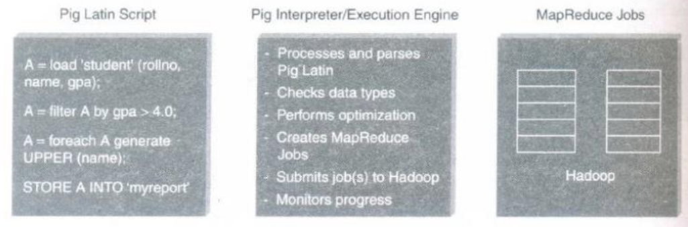

Slide 52
Grunt shell, pig server
Parser: does syntax checking, creates logic plan
Optimizer: optimizes the query
Compiler: compiles logical plan into map reduce jobs

Slide 53
PIG on Hadoop
Pig runs on Hadoop.
Pig uses both Hadoop Distributed File System and MapReduce Programming.
By default, Pig reads input files from HDFS.
Pig stores the intermediate data (data produced by MapReduce jobs) and the output in HDFS.
Pig can also read input from and place output to other sources.

Slide 54
Pig supports the following:
HDFS commands.
UNIX shell commands.
Relational operators.
Positional parameters.
Common mathematical functions.
Custom functions.
Complex data structures.

Slide 55
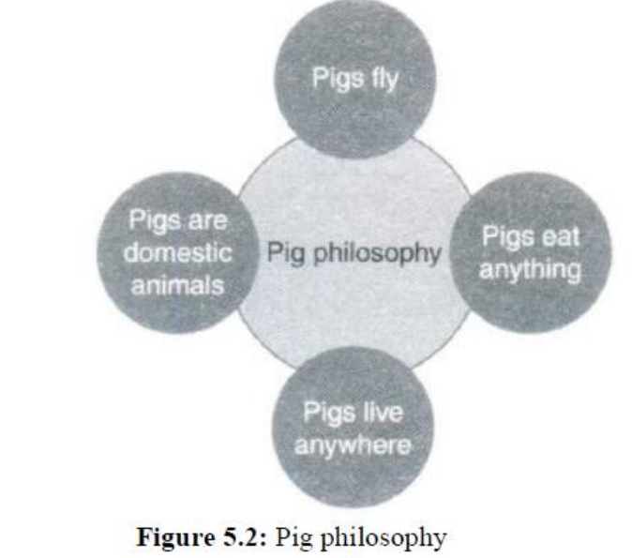
Pig Philosophy

Slide 56
Pigs Eat Anything: Pig can process different kinds of data such as structured and unstructured data.
Pigs Live Anywhere: Pig not only processes files in HDFS, it also processes files in other sources such as files in the local file system.
Pigs are Domestic Animals: Pig allows you to develop user-defined functions and the same can be included in the script for complex operations.
Pigs Fly: Pig processes data quickly.

Slide 57
Pig Latin Overview
Pig Latin statements are basic constructs to process data using Pig.
Pig Latin statement is an operator.
An operator in Pig Latin takes a relation as input and yields another relation as output.
Pig Latin statements include schemas and expressions to process data.
Pig Latin statements should end with a semi-colon.

Slide 58
Pig Latin Statements are generally ordered as follows:
LOAD statement that reads data from the file system.
DUMP or STORE to display/store result.

Slide 59
The following is a simple Pig Latin script to load, filter, and store "student" data.
A = load 'student' (rollno, name, gpa);
A = filter A by gpa > 4.0;
A = foreach A generate UPPER (name);
A: This is a variable name that represents a relation.

Slide 60
Pig Latin Keywords: Keywords are reserved. It cannot be used to name identifiers.

Slide 61
Pig Latin Identifiers
The following are the rules for constructing identifiers in Pig Latin.
Identifiers are names assigned to fields or other data structures.
It should begin with a letter and should be followed only by letters, numbers, and underscores

Slide 62
Pig Latin Comments
In Pig Latin two types of comments are supported:
Single line comments that begin with " __".
Multiline comments that begin with "/* and end with */".

Slide 63
Case Sensitivity in Pig Latin:
1. Keywords are not case sensitive such as LOAD, STORE, GROUP, FOREACH, DUMP, etc.
2. Relations and paths are case-sensitive.
3. Function names are case sensitive such as PigStorage, COUNT.

Slide 64
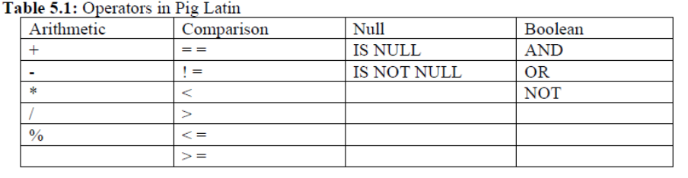
Operators in Pig Latin

Slide 65
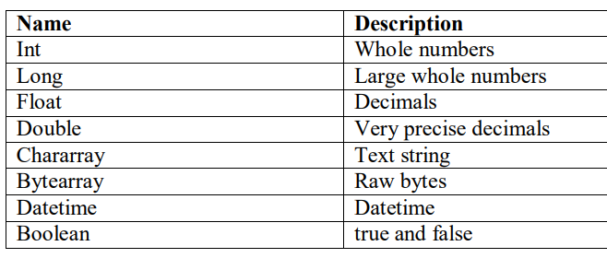
DATA TYPES IN PIG

